Slide 1
MACHINE LEARNING BASED MODEL
TOPIC :- DEPRESSION DETECTION IN HUMANS AND IT’S PROVISIONS.
AIM:- TO PROVIDE A PUBLIC ONLINE PLATFORM FOR DETECTION AND DIAGNOSIS.

Slide 2
OPPORTUNITY STATEMENT
Will provide opportunities for internships & higher educations.
Can prove to be a boom for our future startup plan.
Interaction with medical sector.
Will provide an online public platform to those who can’t afford a high fee & who hesitates to consult a psychiatrist.

Slide 3
SOLUTION
As we all know, depression is among the most prevalent psychiatric disorders. We used media networks to explore various methods of early detections.
Solutions offered are after the detection of depression level we providing either a musical therapy, visual therapy & a online/offline interactions with our psychiatrist/mentors.

Slide 4
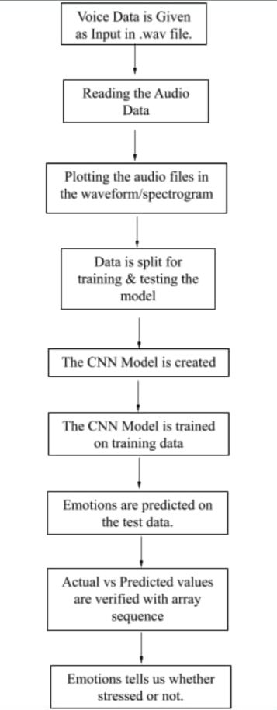
FLOWCHART REPRESENTATION

Slide 5
TARGET MARKET AND SIZE
The target audience are the weaker section employed and unemployed youth and student.
The size is basically the common people covering upto 50% to 60% of the crowd .

Slide 6
PRICING
By asking for our subscription plan so as to interact with the provided mentor

Slide 7
FUNDING
Currently in an ideation phase.

Slide 8
TEAM-1
Member-1: Prabhat Kashyap(Leader)
Member-2: Raghvendra Tyagi
Member-3: Ajay Pratap Singh
Member-4: Rishabh Sharma
Member-5: Nancy Jain
Member-6: Ridam

